Slide 1

EE902 - Advanced ML Techniques for Wireless Communication
eMasters – Q3-2023-24 – Jan-Mar-2024
IIT Kanpur
Venkateswar Reddy Melachervu
CTO
10th Dec 2023
Brillium Technologies
#501, C Block, Salarpuria Serenity, 5th Main, Sector 7, HSR Layout, Bengaluru 560102, Karnataka, India
Website: www.brillium.in | Email: connect@brillium.in

Slide 2
EE902 Course Objectives
Advanced ML algorithms for Wireless Communication
Study of
  Variety of ML algos
    Linear regression, Logistic regression, Support vector machines, Discriminant analysis, etc.
  Data pre-processing techniques
    Principal component analysis for feature selection
  Schemes
    Clustering – K-means, Probabilistic clustering, Naïve Bayes, Decision Tree Classifiers
  Algorithms and their performance analysis
    Algos - Modern probabilistic inference, Online learning, Probabilistic graphic models
    Analysis concepts – Likelihood maximization, Bayesian learning, Independent component analysis

Slide 3
Linear Regression

Slide 4
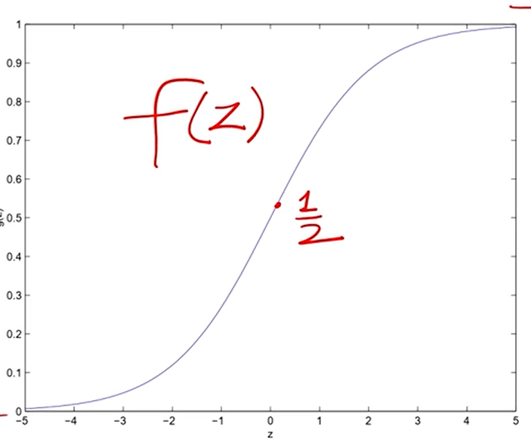
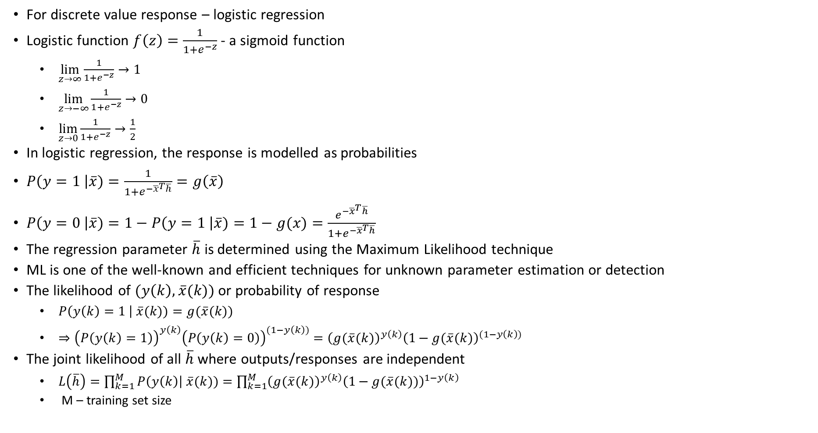
Logistic Regression
For discrete value response – logistic regression
Logistic function $f\left(z\right)=\frac{1}{1+e^{−z}}$ - a sigmoid function
  $\lim_{z→∞}{\frac{1}{1+e^{−z}}→1}$
  $\lim_{z→−∞}{\frac{1}{1+e^{−z}}→0}$
  $\lim_{z→0}{\frac{1}{1+e^{−z}}→\frac{1}{2}}$
In logistic regression, the response is modelled as probabilities
$P\left(y=1 \right|\overline{x})=\frac{1}{1+e^{−{\overline{x}}^{T}\overline{h}}}=g\left(\overline{x}\right)$
$P\left(y=0 \right|\overline{x})=1−P\left(y=1 \right|\overline{x})=1−g(x)=\frac{e^{−{\overline{x}}^{T}\overline{h}}}{1+e^{−{\overline{x}}^{T}\overline{h}}}$
The regression parameter $\overline{h}$ is determined using the Maximum Likelihood technique
ML is one of the well-known and efficient techniques for unknown parameter estimation or detection
The likelihood of $(y\left(k\right),\overline{x}(k))$ or probability of response
  $P\left(y\left(k\right)=1 \right| \overline{x}(k))=g(\overline{x}(k))$
  $⇒{\left(P\left(y\left(k\right)=1\right)\right)}^{y\left(k\right)}{\left(P\left(y\left(k\right)=0\right)\right)}^{(1−y\left(k\right))}={\left(g(\overline{x}(k)\right)}^{y\left(k\right)}{\left(1−g(\overline{x}(k)\right)}^{(1−y\left(k\right))}$
The joint likelihood of all $\overline{h}$ where outputs/responses are independent
  $L\left(\overline{h}\right)=\prod_{k=1}^{M}{P\left(y\left(k\right)\right| \overline{x}(k)})=\prod_{k=1}^{M}{{\left(g(\overline{x}(k)\right)}^{y\left(k\right)}{\left(1−g(\overline{x}(k))\right)}^{1−y\left(k\right)}}$
  M – training set size

Slide 5
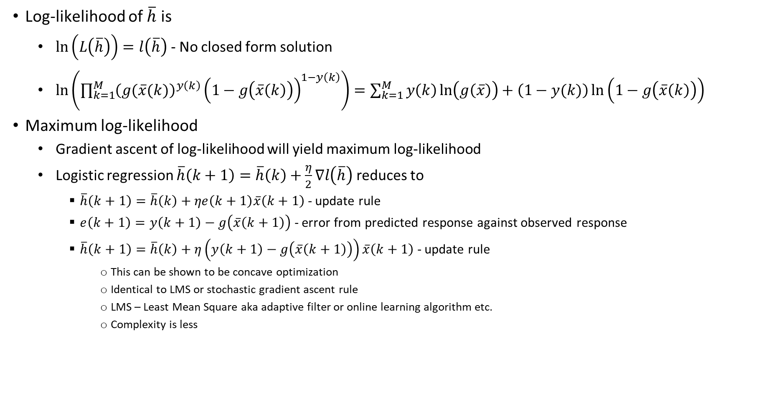
Logistic Regression
Log-likelihood of $\overline{h}$ is
  $\ln\left(L\left(\overline{h}\right)\right)=l\left(\overline{h}\right)$ - No closed form solution
  $\ln\left(\prod_{k=1}^{M}{{\left(g(\overline{x}(k)\right)}^{y\left(k\right)}{\left(1−g\left(\overline{x}\left(k\right)\right)\right)}^{1−y\left(k\right)}}\right)=\sum_{k=1}^{M}{y\left(k\right)\ln\left(g\left(\overline{x}\right)\right)+\left(1−y(k)\right)\ln\left(1−g\left(\overline{x}\left(k\right)\right)\right)}$
Maximum log-likelihood
  Gradient ascent of log-likelihood will yield maximum log-likelihood
  Logistic regression $\overline{h}\left(k+1\right)=\overline{h}\left(k\right)+\frac{η}{2}∇l\left(\overline{h}\right)$ reduces to
    $\overline{h}\left(k+1\right)=\overline{h}\left(k\right)+ηe\left(k+1\right)\overline{x}\left(k+1\right)$ - update rule
    $e\left(k+1\right)=y\left(k+1\right)−g\left(\overline{x}\left(k+1\right)\right)$ - error from predicted response against observed response
    $\overline{h}\left(k+1\right)=\overline{h}\left(k\right)+η\left(y\left(k+1\right)−g\left(\overline{x}\left(k+1\right)\right)\right)\overline{x}\left(k+1\right)$ - update rule
      This can be shown to be concave optimization
      Identical to LMS or stochastic gradient ascent rule
      LMS – Least Mean Square aka adaptive filter or online learning algorithm etc.
      Complexity is less

Slide 6
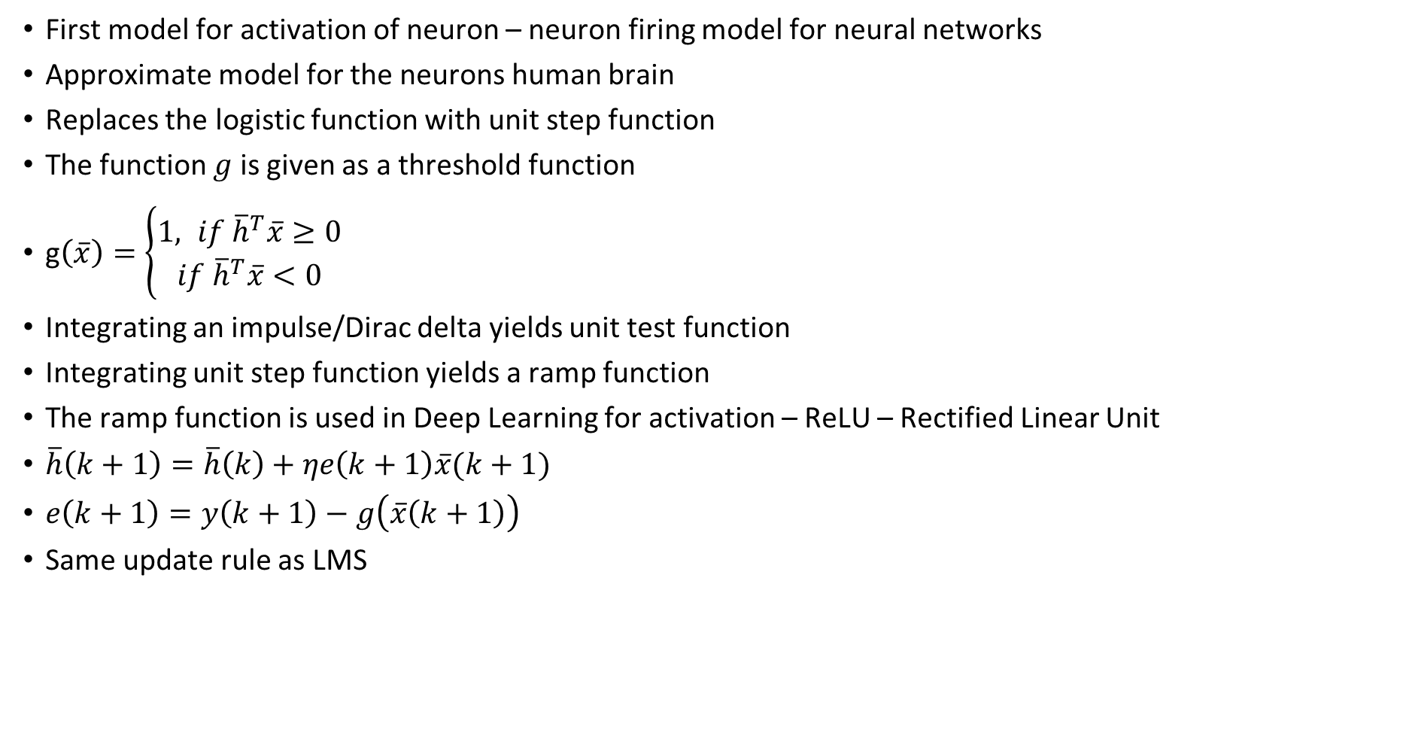
Perceptron Learning Algorithm
First model for activation of neuron – neuron firing model for neural networks
Approximate model for the neurons human brain
Replaces the logistic function with unit step function
The function $g$ is given as a threshold function
g$\left(\overline{x}\right)=\left\{\begin{aligned}1, if {\overline{h}}^{T}\overline{x}≥0 \\ &if {\overline{h}}^{T}\overline{x}<0\end{aligned}\right.$
Integrating an impulse/Dirac delta yields unit test function
Integrating unit step function yields a ramp function
The ramp function is used in Deep Learning for activation – ReLU – Rectified Linear Unit
$\overline{h}\left(k+1\right)=\overline{h}\left(k\right)+ηe\left(k+1\right)\overline{x}(k+1)$
$e\left(k+1\right)=y\left(k+1\right)−g\left(\overline{x}\left(k+1\right)\right)$
Same update rule as LMS

Slide 7
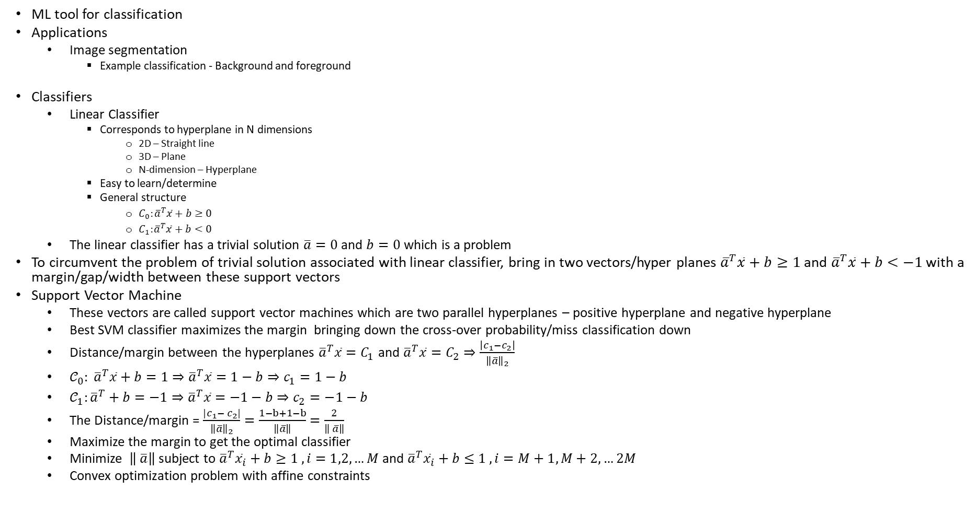
SVM
ML tool for classification
Applications
  Image segmentation
    Example classification - Background and foreground
Classifiers
  Linear Classifier
    Corresponds to hyperplane in N dimensions
      2D – Straight line
      3D – Plane
      N-dimension – Hyperplane
    Easy to learn/determine
    General structure
      $C_{0}:{\overline{a}}^{T}\overline{x}+b≥0$
      $C_{1}:{\overline{a}}^{T}\overline{x}+b<0$
  The linear classifier has a trivial solution $\overline{a}=0$ and $b=0$ which is a problem
To circumvent the problem of trivial solution associated with linear classifier, bring in two vectors/hyper planes ${\overline{a}}^{T}\overline{x}+b≥1$ and ${\overline{a}}^{T}\overline{x}+b<−1$ with a margin/gap/width between these support vectors
Support Vector Machine
  These vectors are called support vector machines which are two parallel hyperplanes – positive hyperplane and negative hyperplane
  Best SVM classifier maximizes the margin bringing down the cross-over probability/miss classification down
  Distance/margin between the hyperplanes ${\overline{a}}^{T}\overline{x}=C_{1}$ and ${\overline{a}}^{T}\overline{x}=C_{2}⇒\frac{\left|c_{1}−c_{2}\right|}{{\left\|\overline{a}\right\|}_{2}}$
  ${𝒞_{0}: \overline{a}}^{T}\overline{x}+b=1⇒{\overline{a}}^{T}\overline{x}=1−b⇒c_{1}=1−b$
  $𝒞_{1}:{\overline{a}}^{T}+b=−1⇒{\overline{a}}^{T}\overline{x}=−1−b⇒c_{2}=−1−b$
  The Distance/margin = $\frac{{|c_{1}− c}_{2}|}{{\left\|\overline{a}\right\|}_{2}}=\frac{1−b+1−b}{\left\|\overline{a}\right\|}=\frac{2}{\left\| \overline{a}\right\|}$
  Maximize the margin to get the optimal classifier
  Minimize $\left\| \overline{a}\right\|$ subject to ${\overline{a}}^{T}{\overline{x}}_{i}+b≥1 , i=1,2,…M$ and ${\overline{a}}^{T}{\overline{x}}_{i}+b≤1 , i=M+1,M+2,…2M$
  Convex optimization problem with affine constraints

Slide 8
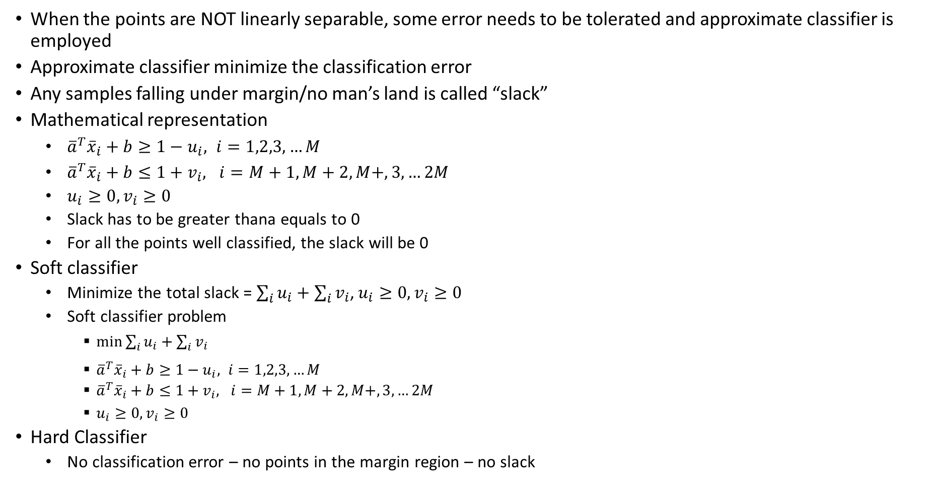
Approximate Classifier
When the points are NOT linearly separable, some error needs to be tolerated and approximate classifier is employed
Approximate classifier minimize the classification error
Any samples falling under margin/no man’s land is called “slack”
Mathematical representation
  ${\overline{a}}^{T}{\overline{x}}_{i}+b≥1−u_{i}, i=1,2,3,…M$
  ${\overline{a}}^{T}{\overline{x}}_{i}+b≤1+v_{i}, i=M+1,M+2,M+,3,…2M$
  $u_{i}≥0, v_{i}≥0$
  Slack has to be greater thana equals to 0
  For all the points well classified, the slack will be 0
Soft classifier
  Minimize the total slack = $\sum_{i}{u_{i}}+\sum_{i}{v_{i}}$, $u_{i}≥0, v_{i}≥0$
  Soft classifier problem
    $\min_{ }{\sum_{i}{u_{i}}+\sum_{i}{v_{i}}}$
    ${\overline{a}}^{T}{\overline{x}}_{i}+b≥1−u_{i}, i=1,2,3,…M$
    ${\overline{a}}^{T}{\overline{x}}_{i}+b≤1+v_{i}, i=M+1,M+2,M+,3,…2M$
    $u_{i}≥0, v_{i}≥0$
Hard Classifier
  No classification error – no points in the margin region – no slack

Slide 9
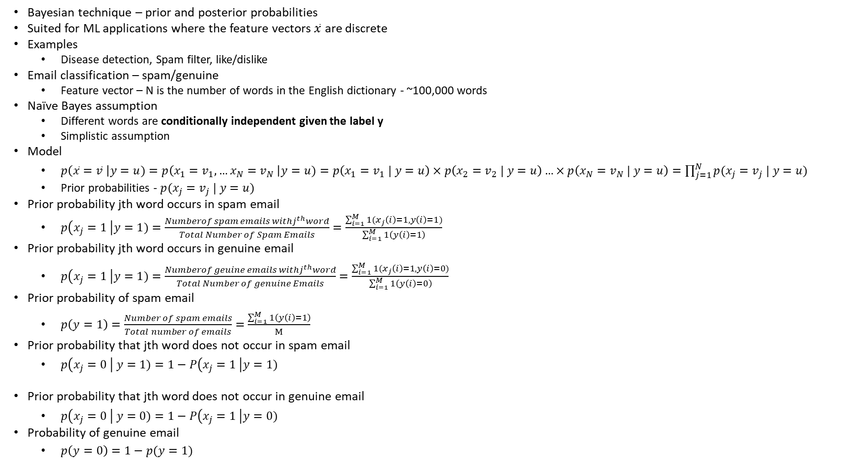
Naïve Bayes
Bayesian technique – prior and posterior probabilities
Suited for ML applications where the feature vectors $\overline{x}$ are discrete
Examples
  Disease detection, Spam filter, like/dislike
Email classification – spam/genuine
  Feature vector – N is the number of words in the English dictionary - ~100,000 words
Naïve Bayes assumption
  Different words are conditionally independent given the label y
  Simplistic assumption
Model
  $p\left(\overline{x}=\overline{v} \right|y=u)=p\left(x_{1}=v_{1},…x_{N}=v_{N} \right|y=u)=p\left(x_{1}=v_{1} | y=u\right)×p\left(x_{2}=v_{2} | y=u\right)…×p\left(x_{N}=v_{N} | y=u\right)=\prod_{j=1}^{N}{p(x_{j}=v_{j} | y=u)}$
  Prior probabilities - $p(x_{j}=v_{j} | y=u)$
Prior probability jth word occurs in spam email
  $p\left(x_{j}=1 \right|y=1)=\frac{{Numberof spam emails withj}^{th}word}{Total Number of Spam Emails}=\frac{\sum_{i=1}^{M}{1(x_{j}\left(i\right)=1,y\left(i\right)=1)}}{\sum_{i=1}^{M}{1\left(y\left(i\right)=1\right)}}$
Prior probability jth word occurs in genuine email
  $p\left(x_{j}=1 \right|y=1)=\frac{{Numberof geuine emails withj}^{th}word}{Total Number of genuine Emails}=\frac{\sum_{i=1}^{M}{1(x_{j}\left(i\right)=1,y\left(i\right)=0)}}{\sum_{i=1}^{M}{1\left(y\left(i\right)=0\right)}}$
Prior probability of spam email
  $p\left(y=1\right)=\frac{Number of spam emails}{Total number of emails}=\frac{\sum_{i=1}^{M}{1\left(y\left(i\right)=1\right)}}{M}$
Prior probability that jth word does not occur in spam email
  $p\left(x_{j}=0 \right| y=1)=1−P\left(x_{j}=1 \right|y=1)$
Prior probability that jth word does not occur in genuine email
  $p\left(x_{j}=0 \right| y=0)=1−P\left(x_{j}=1 \right|y=0)$
Probability of genuine email
  $p\left(y=0\right)=1−p(y=1)$

Slide 10
Thank you
Brillium Technologies
#501, C Block, Salarpuria Serenity, 5th Main, Sector 7, HSR Layout, Bengaluru 560102, Karnataka, India
Website: www.brillium.in | Email: connect@brillium.in

